Slide 1
CSE 225
Tree

Slide 2
Topics Covered
Basic Trees concepts and terminology
Memory Representation of tree
Binary Trees
Traversing Binary trees
Complete and extended binary tree
General Trees

Slide 3
Non-linear List
A non-linear list in data structure is a special type of list having one or more successor
Non-linear list divided into two categories
Non-Linear list
Tree
Graph
Binary Tree
N-ary Tree

Slide 4


Tree
A tree is a finite nonempty set of elements.
It is an abstract model of a hierarchical structure.
Trees are used extensively in computer science to represent algebraic formula, an efficient method for searching large , dynamic list and in file system
leaves
branches
root
Nature View of a Tree
Computer Scientist’s View

Slide 5
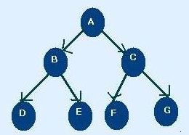
Tree Terminology
Node : each of the elements or data that constructs tree. i.e. A, B, C, D, E, F
Edges: Finite set of directed lines that connects node
Root: The first Node of tree(If tree is not empty) i.e. A
In Degree : The number of edges comes into particular node
Node | In Degree
A | 0
B | 1
C | 1
D | 1
E | 1
F | 1
G | 1

Slide 6
Tree Terminology
Out Degree : The number of edges comes out from a particular node
Node | Out Degree
A | 2
B | 2
C | 2
D | 0
E | 0
F | 0
G | 0

Slide 7
Tree Terminology
Total Degree : Summation of Indegree and outdegree
N.B: Each node except root node of tree must have an indegree of 1
Node | Indegree | outdegree | degree
A | 0 | 2 | 2
B | 1 | 2 | 3
C | 1 | 2 | 3
D | 1 | 0 | 1
E | 1 | 0 | 1
F | 1 | 0 | 1
G | 1 | 0 | 1

Slide 8
Tree Terminologies
Leaf : Nodes that have outdegree 0 i.e. no successor. i.e. D, E,F,G
Internal Node : A node that is not root or leaf node. It is found in middle portion of tree i.e. B,C
Parent Node: Nodes that have outdegree greater than 0 i.e. it has successor node i.e. A, B, C
Child Node: Nodes that have indegree 1 i.e. one predecessor
i.e. B, C, D, E, F, G, H
Sibling : Nodes having same parent i.e. B,C are sibling and D, E and F,G are sibling
Path: A sequence of connected node from one node to another. i.e. path from root to D is ABD, path from C to G is CG
Ancestor of a Node : Any node in the path from root to that node. i.e. Ancestor of D is A,B
Descendent of a Node : All node in the path from that node to the leaf node. i.e. Descendent of : B is D

Slide 9
Tree Terminology
Level/depth: level of a node is its distance from root. i.e. root has 0 distance from itself, so root is at level 0
the children of the root are at level 1 and their children are at level 2 and so on
Height : Maximum level of any node in the tree.i.e. 2
Subtrees: A tree may be divided into subtrees. The first node of the subtree is considered as root and is used to name the subtree. i.e BDE, CFG
Level 0
Level 1
Level 2

Slide 10
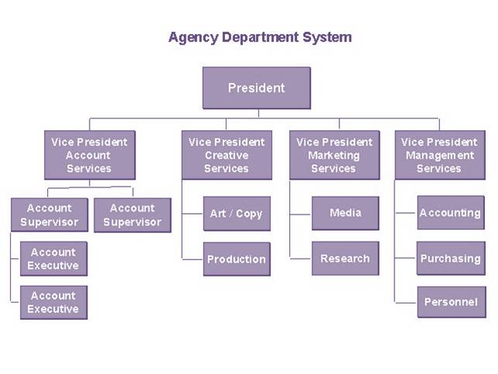
Use of tree
Tree represents a hierarchy for. e.g. the organization structure of a company.
Table of contents of a book
Unix or Windows file system

Slide 11
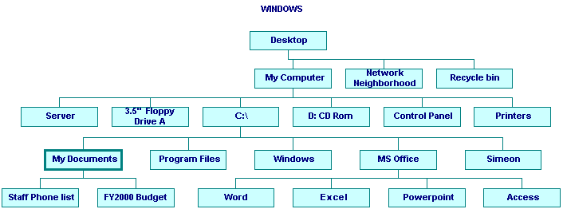
Use of tree
Unix or Windows file system

Slide 12
Trees
Every tree node:
object – useful information
children – pointers to its children
Data
Data
Φ
Φ
Data
Φ
Data
Φ
Φ
Data
Φ
Φ
Data
Φ
Φ
Data
Φ
Φ

Slide 13
A Tree Representation
A node is represented by an object storing
Element
Parent node
Sequence of children nodes
∅
B
∅
∅
A
D
F
B
A
D
F
∅
∅
C
E
C
E

Slide 14
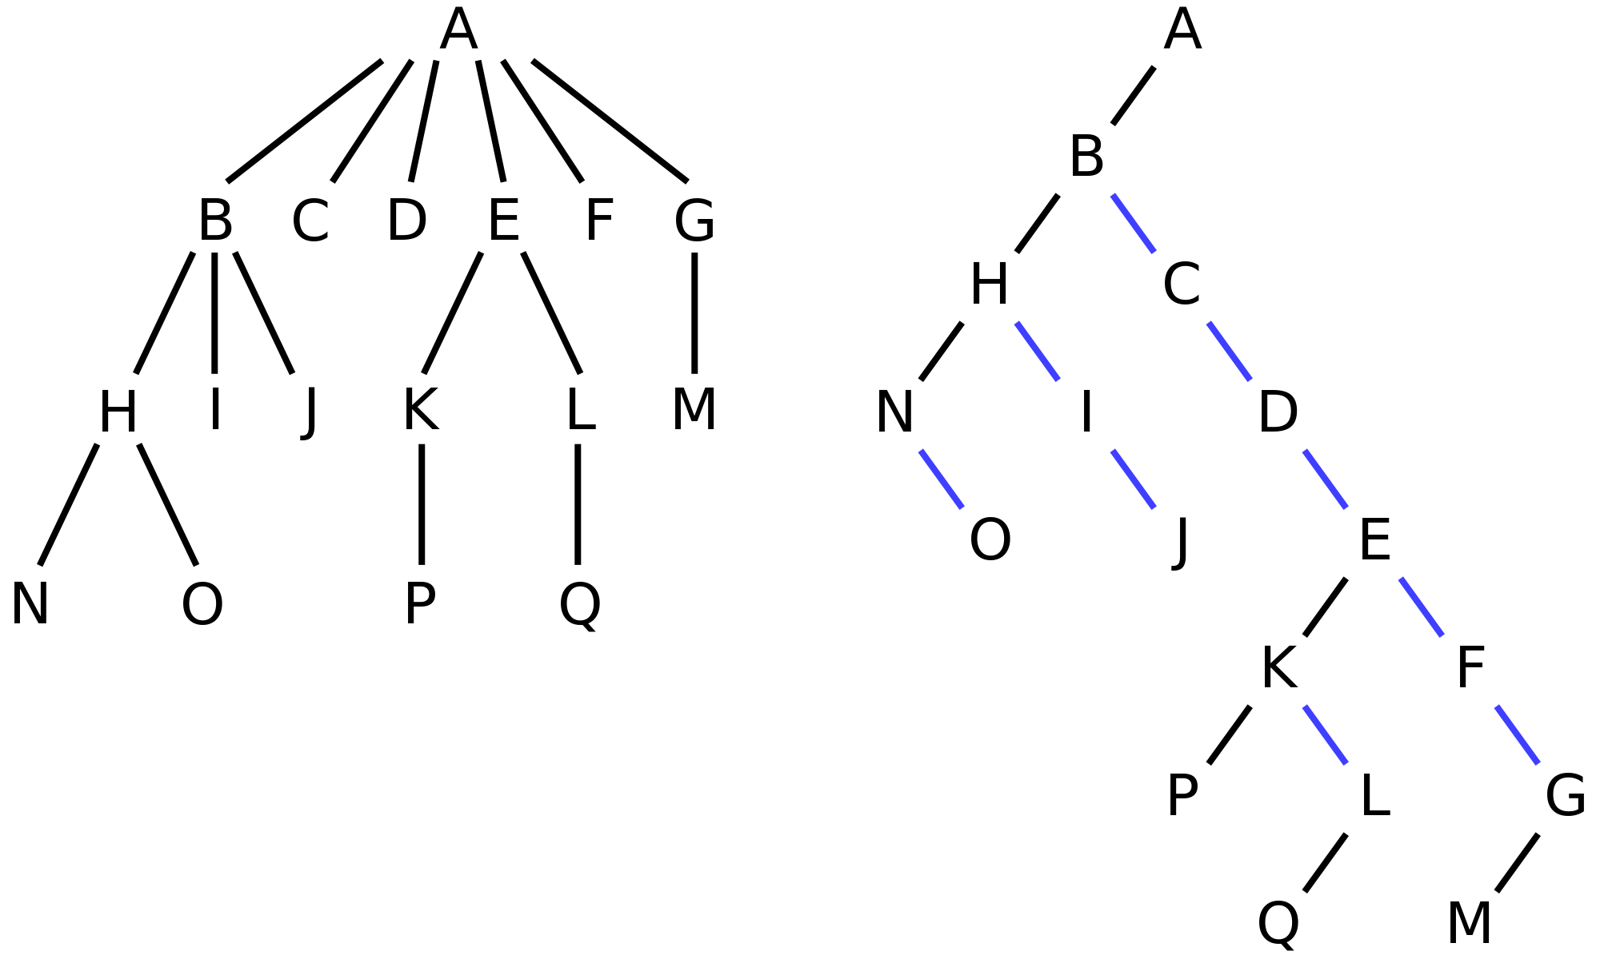
Left Child, Right Sibling Representation
Data
Left Child
Right Sibling

Slide 15
Inclass Exercise Draw the tree
Data
Left Child
Right Sibling
A
B
C
D
E
F
G
H
I
J
K
L

Slide 16
Tree Traversal
Two main methods:
Preorder
Postorder
Recursive definition
Preorder:
visit the root
traverse in preorder the children (subtrees)
Postorder
traverse in postorder the children (subtrees)
visit the root

Slide 17
Preorder Traversal
A traversal visits the nodes of a tree in a systematic manner
In a preorder traversal, a node is visited before its descendants
Application: print a structured document
Algorithm preOrder(v)
visit(v)
for each child w of v
preorder (w)
1
Become Rich
2
5
9
1. Motivations
2. Methods
3. Success Stories
3
4
6
7
8
1.1 Enjoy Life
1.2 Help Poor Friends
2.1 Get a CS PhD
2.2 Start a Web Site
2.3 Acquired by Google

Slide 18
Postorder Traversal
In a postorder traversal, a node is visited after its descendants
Application: compute space used by files in a directory and its subdirectories
Algorithm postOrder(v)
for each child w of v
postOrder (w)
visit(v)
9
cs16/
8
3
7
homeworks/
programs/
todo.txt 1K
1
2
4
5
6
h1c.doc 3K
h1nc.doc 2K
DDR.java 10K
Stocks.java 25K
Robot.java 20K

Slide 19
Binary Tree
A binary tree is a tree with the following properties:
Each internal node has at most two children (degree of two)
The children of a node are an ordered pair
We call the children of an internal node left child and right child
Alternative recursive definition: a binary tree is either
a tree consisting of a single node, OR
a tree whose root has an ordered pair of children, each of which is a binary tree
Applications:
arithmetic expressions
decision processes
searching
A
B
C
D
E
F
G
H
I

Slide 20
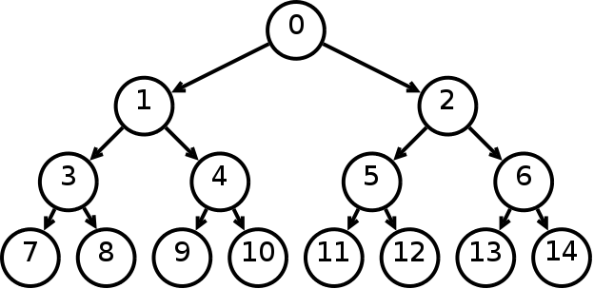
Complete Binary tree
Every nodes (except leaf) having two nodes.
Maximum number of nodes in Level i is 2^{i .} i.e. nodes in level 0= 2⁰ = 1, level 1 = 2¹ = 2
In a tree of height h
No. of leaves at level h is 2^{h}
If the tree has n nodes then,
n <= 2^{h+1} -1
=> h >= log₂ (n+1) -1
A binary tree has at least height of log₂ (n+1) -1 which is a complete binary tree
L=0
L=1
L=2
L=3

Slide 21
Minimum height of a Binary trees
A binary tree of height h has,
At most 2^{i} nodes in level i
At most 2⁰ + 2¹ + 2² +………..+ 2^{h} = 2^{h+1} -1 nodes
If the tree has n nodes then,
n <= 2^{h+1} -1
=> h >= log₂ (n+1) -1
A binary tree has at least height of log₂ (n+1) -1 which is a complete binary tree

Slide 22
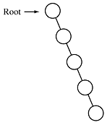
Maximum height of a Binary trees
If the tree has n nodes then the height is n-1
This is obtained when every node has exactly one child (except leaf node)

Slide 23
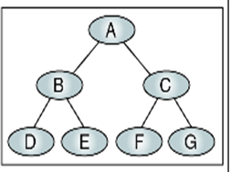
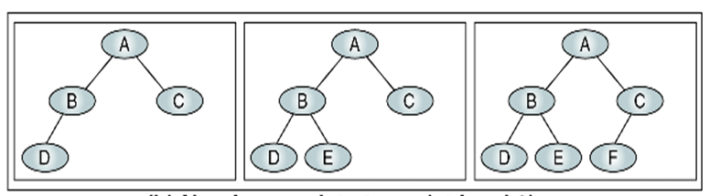
Near Complete Binary Tree
If a tree has the minimum height for its nodes and all nodes in the last level are found on the left is called near complete binary tree.

Slide 24
Binary Tree Traversal
Each Node of the tree must be processed once and only once in a predetermined sequence
Two general approach-
Depth First traversal
Breadth first traversal
Depth First traversal, the processing proceeds along a path from the root through one child to the most descendent of that first child before processing a second child
Breadth first traversal (level by level), the processing proceeds horizontally from the roots to all its children (left to right usually) i.e. A B C D E F G

Slide 25
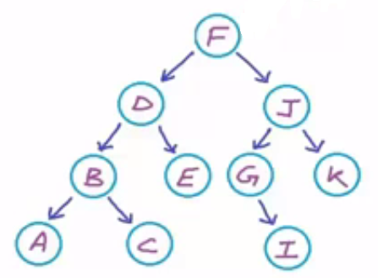
Depth First Traversal
Three Standard traversal techniques :
Preorder traversal
<root > <left> <right>
Visit the root
Visit the left subtree
Visit the right subtree
i.e. F D B A C E J G I K
2. Inorder traversal
<left> <root > <right>
Visit the left subtree
Visit the root
Visit the right subtree
i.e. A B C D E F G I J K

Slide 26
Depth First Traversal
Three Standard traversal techniques :
Postorder traversal
<left> <right> <root >
Visit the left subtree
Visit the right subtree
Visit the root
i.e. A C B E D I G K J F

Slide 27
Expression Trees
An expression tree is a binary tree with following properties :
Each leaf is an operand
The root and internal nodes are operator
Sub trees are sub expressions with the root being an operator
+
d
*
a * (b + c) +d
a
+
b
c

Slide 28
Infix Traversal
Algorithm infix (tree)
if (tree not empty)
if(tree token is an operand)
print (tree token)
else
print ( open parenthesis)
infix (tree left subtree)
print (tree token)
infix (tree right subtree)
print (close parenthesis)
end if
end if;
+
*
d
a
+
((a * (b + c)) +d)
b
c

Slide 29
Prefix Traversal
Algorithm prefix (tree)
if (tree not empty)
print (tree token)
prefix (tree left subtree)
prefix (tree right subtree)
end if;
+
*
d
a
+
b
c
+*a+bcd

Slide 30
Postfix Traversal
+
Algorithm postfix (tree)
if (tree not empty)
postfix (tree left subtree)
postfix (tree right subtree)
print (tree token)
end if;
*
d
a
+
b
c
abc+*d+

